Slide 1
Game Reviews
Sentiment Analysis
Damar - JCDS10

Slide 2
WHAT IS SENTIMENT ANALYSIS?
Natural language processing and machine learning technique to interpret and classify emotions in subjective data. Sentiment analysis is often used in business to detect sentiment in social data, gauge brand reputation, and understand customers.

Slide 3

WHY REVIEWS IS IMPORTANT?
There are a lot of aspects that may have contributed to the game’s success, and reviews can be a contributing factor.
Game Reviews could play a Factor in Word-Of-Mouth and affect Game Purchases
Game Quality is Imperative to Game Review. In order to get Positive Review, developer must improve their Game Quality

Slide 4
MAIN PROBLEM
Scanning through every Reviews is time consuming
Getting Reviews only from small group of players (e.g. veteran player) doesn’t represent the “voice” of majority
Can’t identify critical issues in real-time

Slide 5
OUR GOALS
Identify sentiment score (positive, neutral or negative ) from each reviews
Identify topics within review datasets

Slide 6


DATASETS

Slide 7
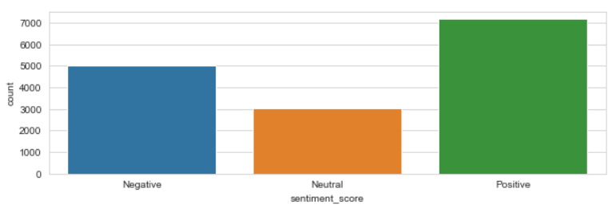
DATASETS

Slide 8
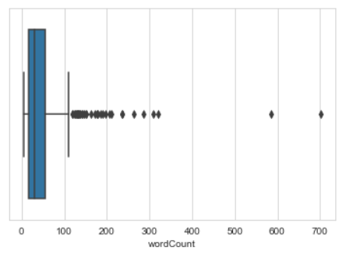
DATASETS

Slide 9
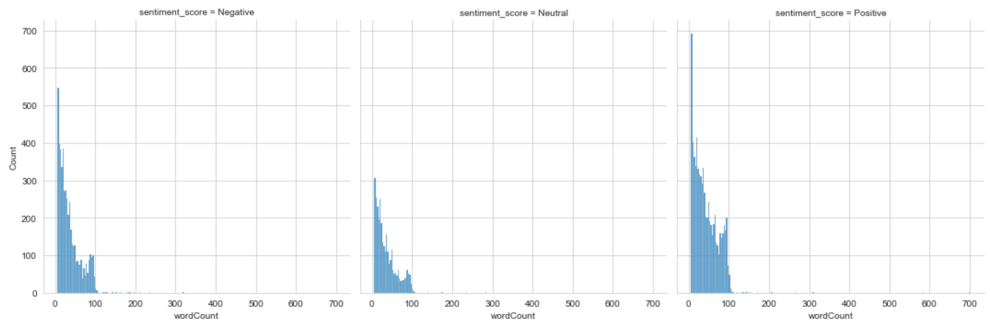
DATASETS

Slide 10
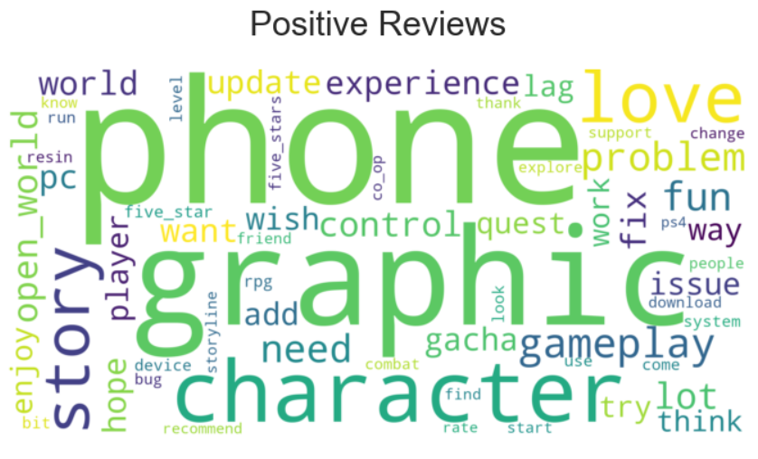

Slide 11
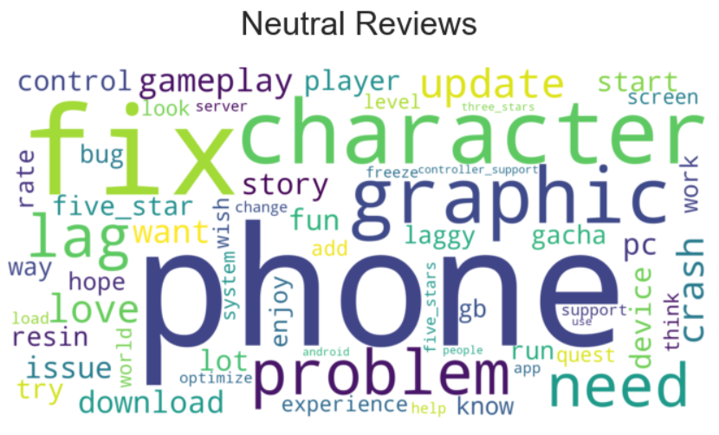

Slide 12
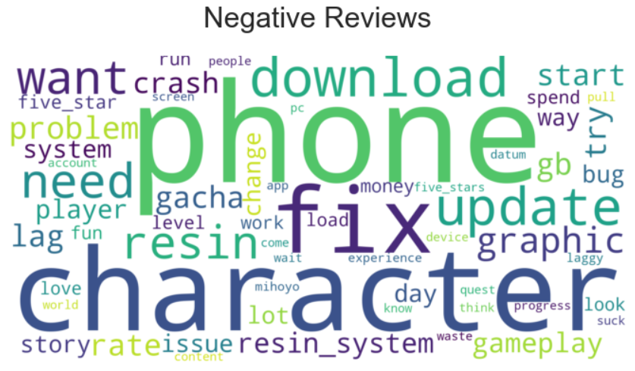

Slide 13
METHODS
LANGUAGE FILTER
MODEL BUILDING
TOKENIZE AND TEXT CLEANING
MODEL VALIDATION
1
4
LEMMATIZE AND REMOVE STOPWORD
6
GENERATE TOPIC
2
5
3

Slide 14
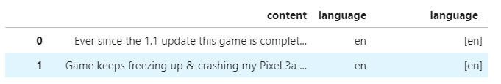
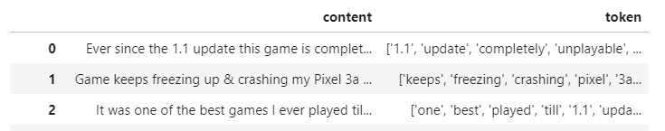
LANGUAGE FILTER
TOKENIZE AND TEXT CLEANING

Slide 15
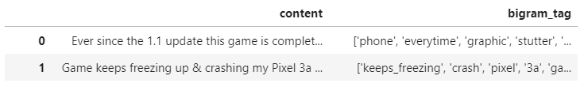
LEMMATIZE AND REMOVE STOPWORD

Slide 16
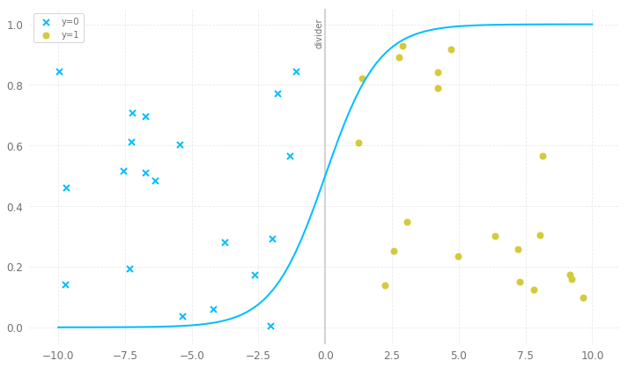
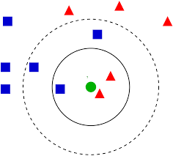
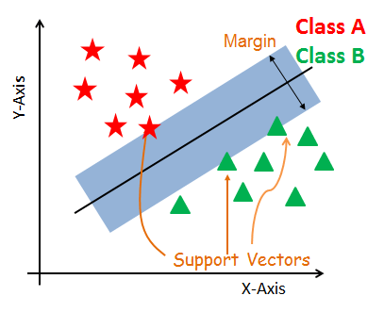
MODEL BUILDING
Logistic Regression
KNN Classifier
SVC

Slide 17
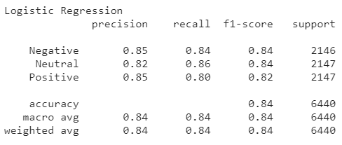
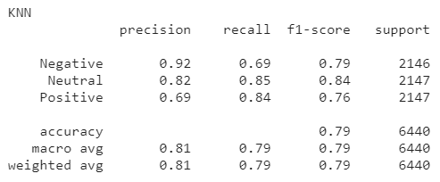
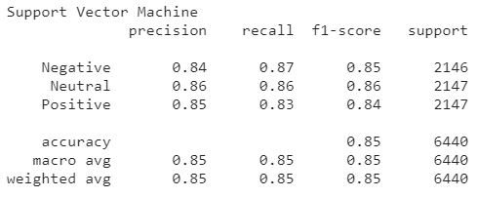

MODEL VALIDATION

Slide 18
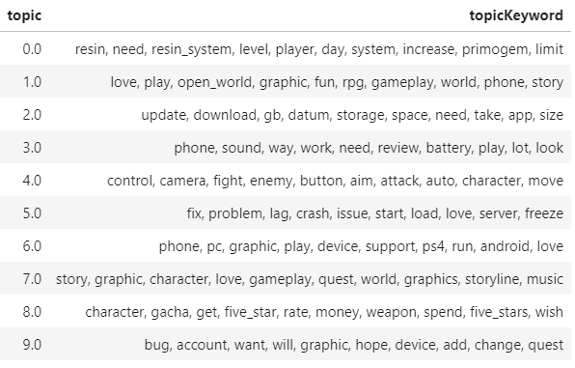
LATENT DIRICHLET ALLOCATION
0. : "Resin/Stamina System"
1. : "Game Mechanic"
2. : "Update"
3. : "Misc"
4. : "Action Control"
5. : "Lagging and Crashing"
6. : "Controller Support"
7. : "Game Feature"
8. : "Character and Gacha Rates"
9. : "Bug and Account Issue"

Slide 19
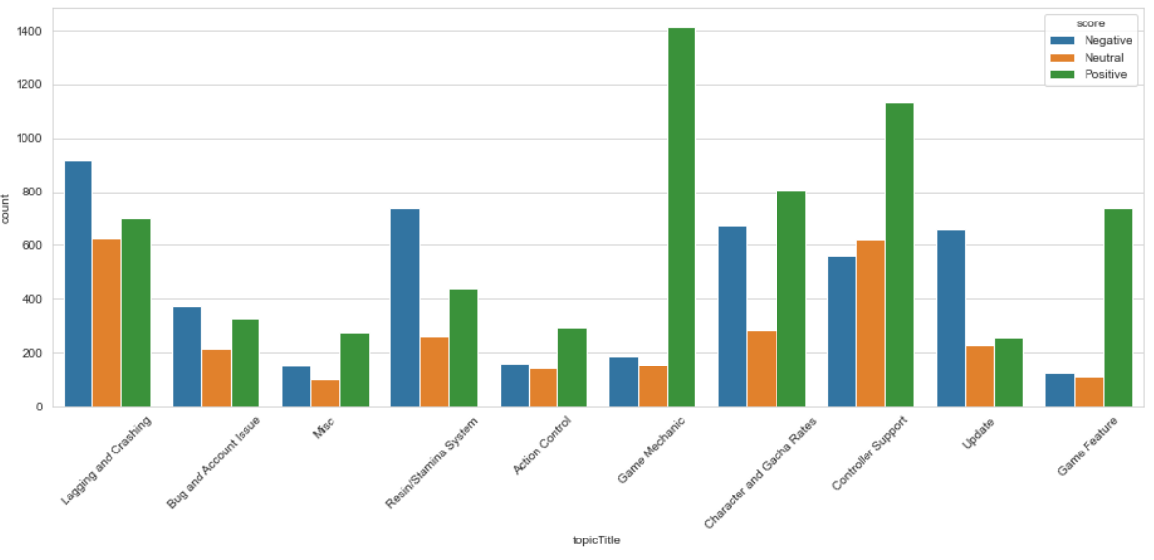
LATENT DIRICHLET ALLOCATION

Slide 20
CONCLUSION
There are 7155 Positive Reviews, 5000 Negative Reviews and 3046 Neutral Reviews
From Gensim LDA models, there are 10 generated topics
2 most frequent topics are "Controller Support" with 2321 Reviews and "Lagging and Crashing" with 2272 Reviews
2 least frequent topics are "Misc" with 531 Reviews and "Action Controls" with 592 Reviews
"Resin/Stamina System", "Update", "Account Issue" and "Lagging and Crashing" were dominated by Negative Reviews
Game Mechanic and Game Features had the highest Positive Reviews percentage.

Slide 21
RECOMMENDATION
For "Lagging and Crashing", players getting lag caused by bad connection, server capacity or minimum/low device specification. Crashing can happen because of user device specification or unstable application. It's recommended to optimize apps stability and add low setting for potato devices. Increasing server capacity isn't urgently needed because lag can be caused by user's bad connection.
For "Update" issue, players complained about the size of update which "too big" for them and low download speed while downloading update package. It's recomended to compress upgrade package and increase server capacity everytime update is available for download if possible.
For "Bug and Account Issue", players complained about customer support's slow or even not getting any response. It is recomended to make improvement on Customer Support section, because account is extremely important to access the game. Player also found some in-game bugs and should be fixed as soon as possible to prevent bug-exploit behavior.
For "Resin/Stamina System", player complained about resin/stamina system obstructing game progress. Player need to spend game currency that cost real money to refill stamina. it is recomended to increase stamina recharge rate or daily cap so player can increase their playtime and make further progress on their game.
Machine Learning Models has better performance predicting review with more than 6 words. (72% accuracy while predicting review with less than 6 words)

Slide 22
FUTURE WORKS
Support Multi-language
Able to filter typo
Make the model more generally applicable to most games

